Slide 1

Lecture 04 (Part 2) – Economics
IT3090 - Business Management for IT- Lecture 04 - Ms. Nilmini Rathnayake

Slide 2
LEARNING OUTCOMES
At the end of the lecture, students should be able to;
Understand the basic economic concepts.
Explain the concept of demand and supply.
Identify the market structures and their characteristics.
IT3090 - Business Management for IT- Lecture 04 - Ms. Nilmini Rathnayake

Slide 3
Demand and Supply.
IT3090 - Business Management for IT- Lecture 04 - Ms. Nilmini Rathnayake

Slide 4
The Assumptions
The law of demand and low of supply are based on two assumptions;
CETERIS PARISBUS –
One factor will change at one time. All the other factors remain constant.
The consumers are rational -
The buyers and supplier are aware of the conditions in the market
IT3090 - Business Management for IT- Lecture 04 - Ms. Nilmini Rathnayake

Slide 5
The Concept of Demand
Demand:
The quantity that people are willing to buy at a given price and during a period of time.
The term demand signifies the ability or the willingness to buy a particular commodity at a given point of time.
IT3090 - Business Management for IT- Lecture 04 - Ms. Nilmini Rathnayake

Slide 6
The factors that affect demand
Price of the product
Income of the buyers
Price of other goods
Substitutes
Complements
Taste and fashion
Expectation
Social reasons
Population, Gender, Age structure, etc.
IT3090 - Business Management for IT- Lecture 04 - Ms. Nilmini Rathnayake

Slide 7
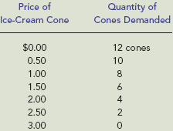
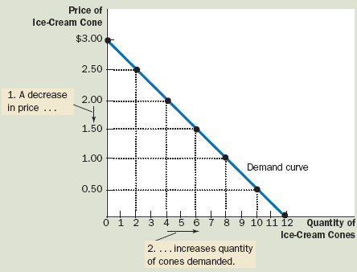
Price and Quantity Demanded: The Law of Demand
The law of demand
The negative relationship between price and quantity demanded.
As price rises, quantity demanded decreases; as price falls, quantity demanded increases.
Price
QD
Demand schedule
A table showing how much of a given product a household would be willing to buy at different prices.
Demand curve
A graph illustrating how much of a given product a household would be willing to buy at different prices.
Demand Curves Slope Downward
When price rises, quantity demanded falls, and when price falls, quantity demanded rises. There is a negative relationship between quantity demanded and price.
IT3090 - Business Management for IT- Lecture 04 - Ms. Nilmini Rathnayake

Slide 8
“A Change in Quantity Demand” and “Increase and Decrease in Demand”
A Change in Quantity Demand :
Occurs as a result of a change in the price.
An increase and decrease Demand :
Occurs as a result of the changes in other factors and not the price.
IT3090 - Business Management for IT- Lecture 04 - Ms. Nilmini Rathnayake

Slide 9
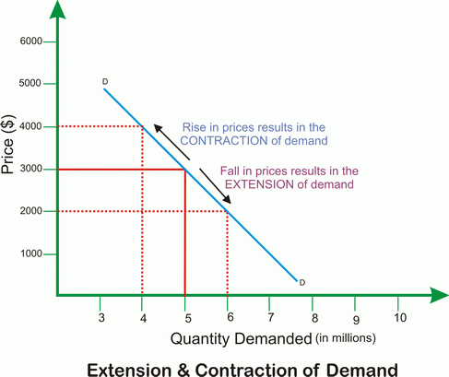
A Change in Quantity Demand
Contraction
When the prices rises, the quantity demanded will fall.
It is a movement upward along the demand curve.
Extension
When the prices fall, the quantity demanded will rise.
This is a movement downwards along the demand curve.
IT3090 - Business Management for IT- Lecture 04 - Ms. Nilmini Rathnayake

Slide 10
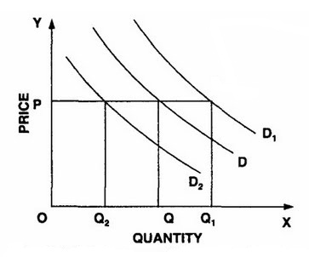
Increases and Decreases in Demand
Change in factors other than Price;
The factor affecting demand | Increase Demand |  | Decrease Demand
Taste | Increase | Increase | Decrease | Decrease
Population | Increase | Increase | Decrease | Decrease
Income | Increase | Increase demand if a normal good | Decrease | Increase demand if an inferior good.
Substitute | Increase in price | Increase | Decrease in price | Decrease
Complement | Increase in price | Decrease demand | Decrease in price | Increase demand
Expectations of the price of the product | Increase | Increase | Decrease | Decrease
IT3090 - Business Management for IT- Lecture 04 - Ms. Nilmini Rathnayake

Slide 11
Concept of Supply
Supply
The quantity of a product that the suppliers are willing to supply at a given price and at a given time.
The amount produced or output available or the stocks of goods available are not the supply.
The supply is the amount offered for sales.
IT3090 - Business Management for IT- Lecture 04 - Ms. Nilmini Rathnayake

Slide 12
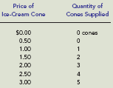
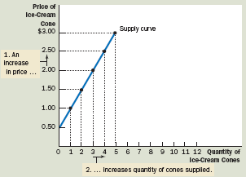
Price and Quantity Supplied: The Law of Supply
Law of supply
The positive relationship between price and quantity of a good supplied.
An increase in market price will lead to an increase in quantity supplied, and a decrease in market price will lead to a decrease in quantity supplied.
Supply Curves Slope Upward
A producer will supply more
when the price of output is
higher. The slope of a supply
curve is positive.
Supply schedule
A table showing how much of a product firms will sell at alternative prices.
Supply curve
A graph illustrating how much of a product a firm will sell at different prices.
IT3090 - Business Management for IT- Lecture 04 - Ms. Nilmini Rathnayake

Slide 13
“A Change in Quantity Supply” and “Increase and Decrease in Supply”
A Change in Quantity Supply :
Occurs as a result of a change in the price.
An increase and decrease Supply :
Occurs as a result of the changes in other factors and not the price.
IT3090 - Business Management for IT- Lecture 04 - Ms. Nilmini Rathnayake

Slide 14
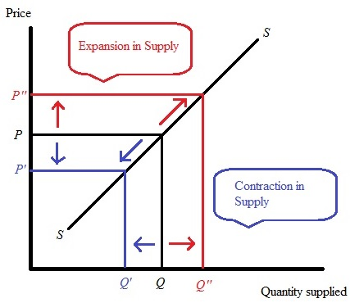
A Change in Quantity Supply
Extension
When the prices rises, the quantity supplied will increase.
It is a movement upward along the supply curve.
Contraction
When the prices fall, the quantity supplied will fall.
It is a movement downwards along the supply curve.
IT3090 - Business Management for IT- Lecture 04 - Ms. Nilmini Rathnayake

Slide 15
Increases and Decreases in Supply
Change in factors other than Price;
The factor affecting demand | Increase Supply |  | Decrease Supply
Technology | Increase | Increase | Decrease | Decrease
Resource prices | Increase | Decrease | Decrease | Increase
Substitute Prices | Increase | Decrease | Decrease | Increases
Expectations of suppliers | Increase | Decease | Decrease | Increase
Government policies | Increase | Decrease | Decrease | Increase
IT3090 - Business Management for IT- Lecture 04 - Ms. Nilmini Rathnayake

Slide 16
Market Equilibrium
Equilibrium
The condition that exists when quantity supplied and quantity demanded are equal. At equilibrium, there is no tendency for price to change.
The operation of the market depends on the interaction between suppliers and demanders.
At any moment, one of three conditions prevails in every market:
(1) The quantity demanded exceeds the quantity supplied at the current price, a situation called excess demand;
(2) the quantity supplied exceeds the quantity demanded at the current price, a situation called excess supply; or
(3) the quantity supplied equals the quantity demanded at the current price, a situation called equilibrium.
IT3090 - Business Management for IT- Lecture 04 - Ms. Nilmini Rathnayake

Slide 17
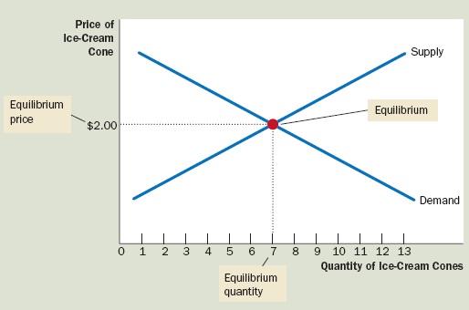
Equilibrium price
The price that balances quantity supplied and
quantity demanded
Equilibrium quantity
The quantity supplied and the quantity demanded at the equilibrium price
IT3090 - Business Management for IT- Lecture 04 - Ms. Nilmini Rathnayake

Slide 18
Equilibrium
QD=QS
QD = a – bp
QS = a + bp
Qd = 100-10P Qs = 40+5P
Qd = 80-5P Qs = 20+10P
IT3090 - Business Management for IT- Lecture 04 - Ms. Nilmini Rathnayake

Slide 19
IT3090 - Business Management for IT- Lecture 04 - Ms. Nilmini Rathnayake

